Slide 1
McNemar and Cohen’s Kappa

Slide 2
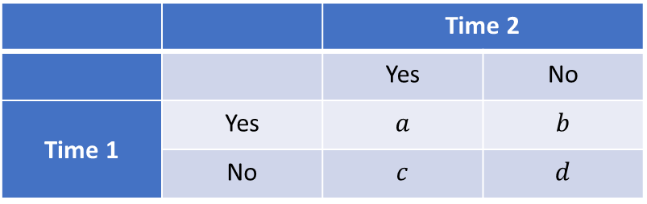
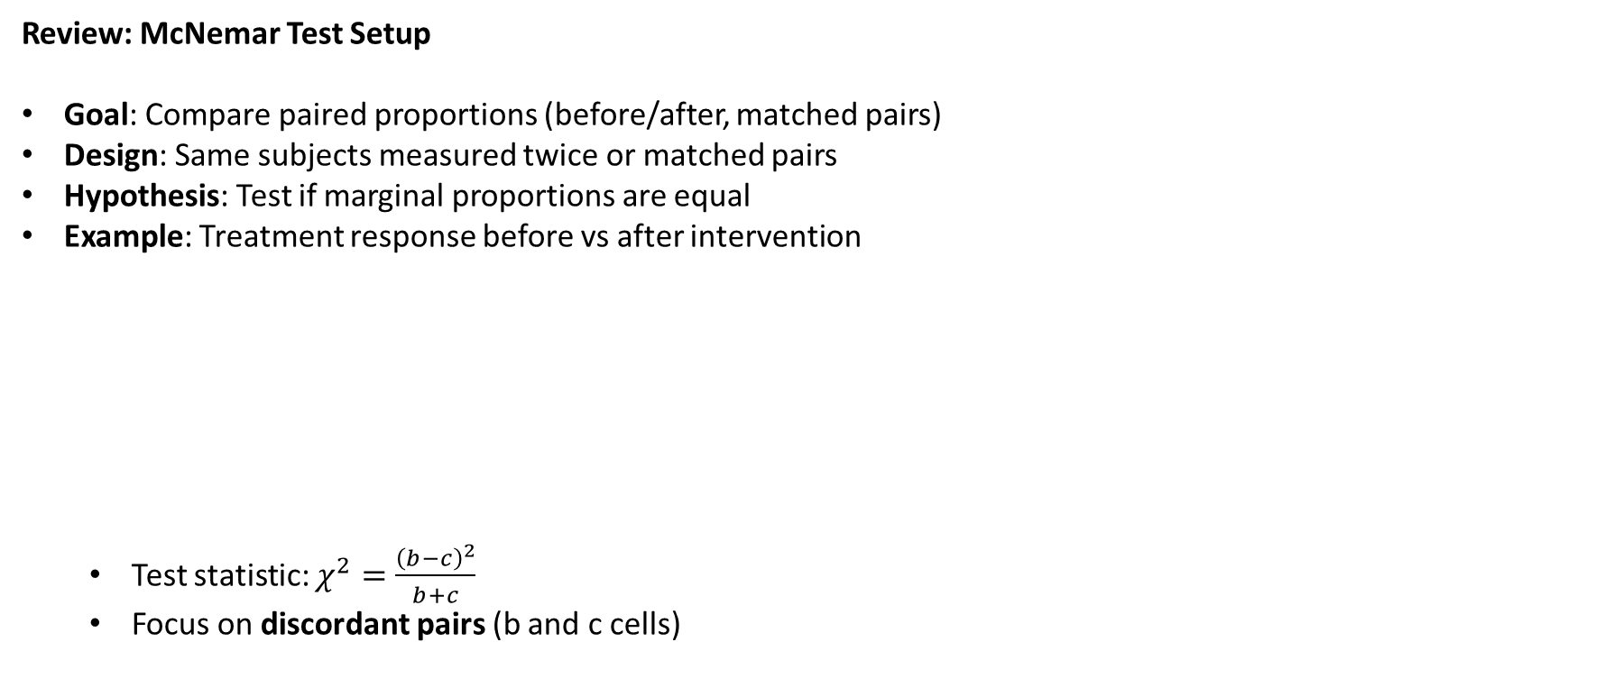
McNemar Test and Cohen's Kappa
Review: McNemar Test Setup
Goal: Compare paired proportions (before/after, matched pairs)
Design: Same subjects measured twice or matched pairs
Hypothesis: Test if marginal proportions are equal
Example: Treatment response before vs after intervention
  Test statistic: $χ^{2}=\frac{{\left(b−c\right)}^{2}}{b+c}$
  Focus on discordant pairs (b and c cells)
 |  | Time 2
 |  | Yes | No
Time 1 | Yes | $$a$$ | $$b$$
 | No | $$c$$ | $$d$$

Slide 3
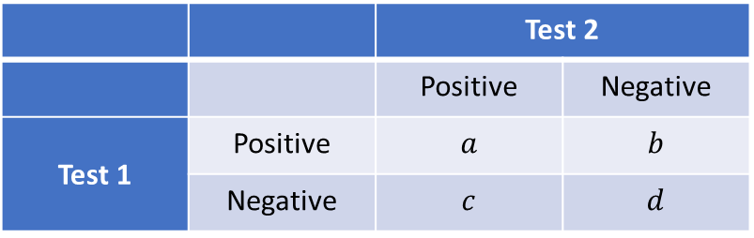
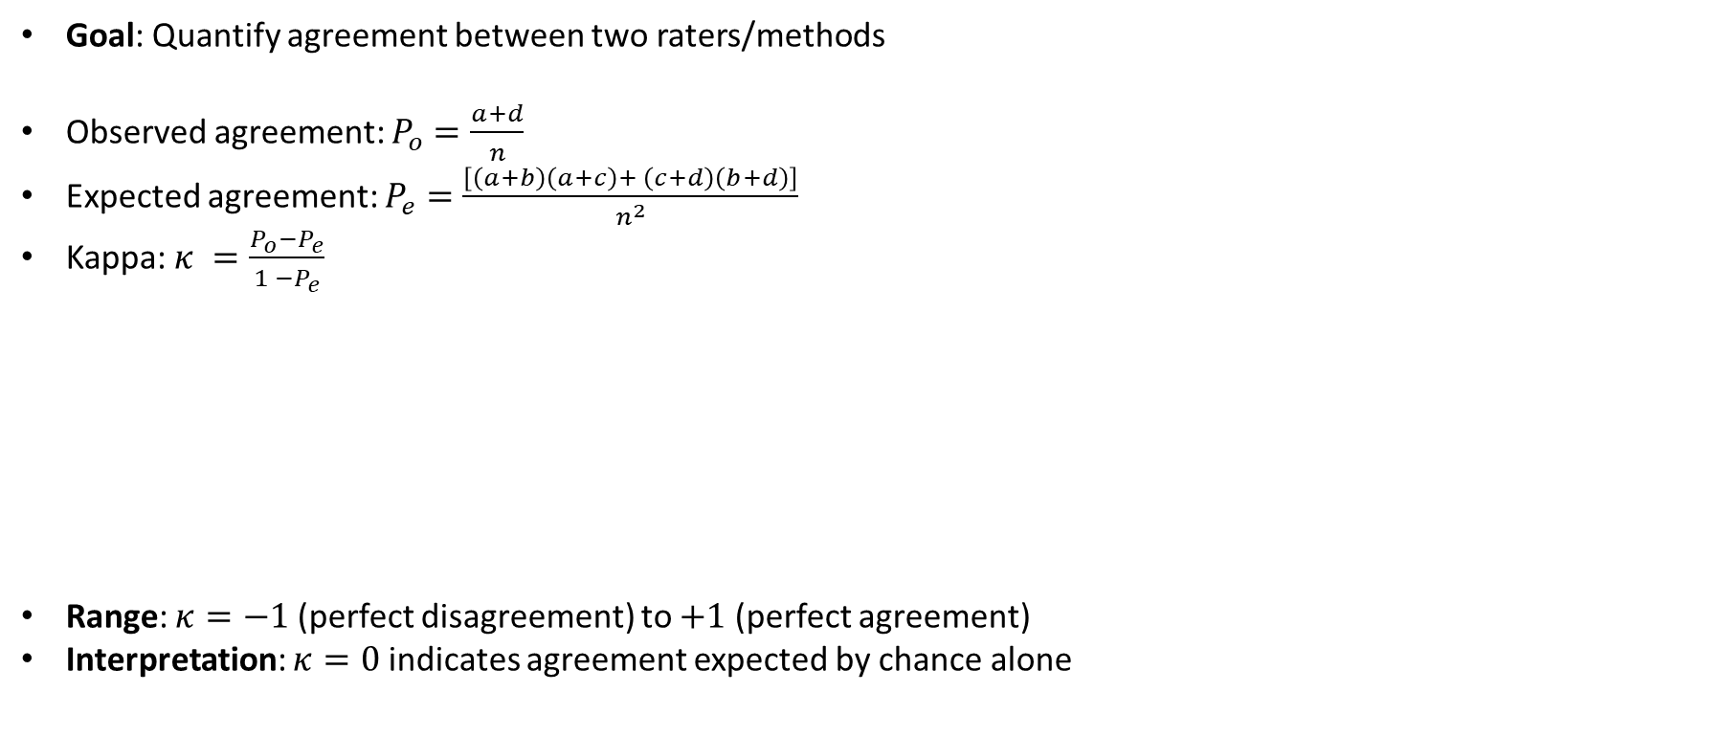
Cohen's Kappa: Measuring Agreement
Goal: Quantify agreement between two raters/methods
Observed agreement: $P_{o}=\frac{a+d}{n}$
Expected agreement: $P_{e}=\frac{\left[\left(a+b\right)\left(a+c\right)+ \left(c+d\right)\left(b+d\right)\right]}{n^{2}}$
Kappa: $κ =\frac{P_{o}−P_{e}}{1 −P_{e}}$
Range: $κ=−1$ (perfect disagreement) to $+1$ (perfect agreement)
Interpretation: $κ=0$ indicates agreement expected by chance alone
 |  | Test 2
 |  | Positive | Negative
Test 1 | Positive | $$a$$ | $$b$$
 | Negative | $$c$$ | $$d$$

Slide 4
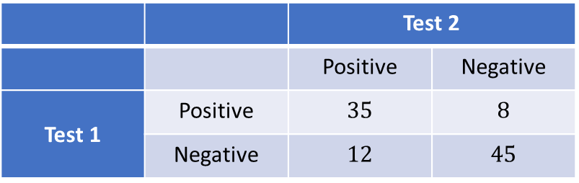
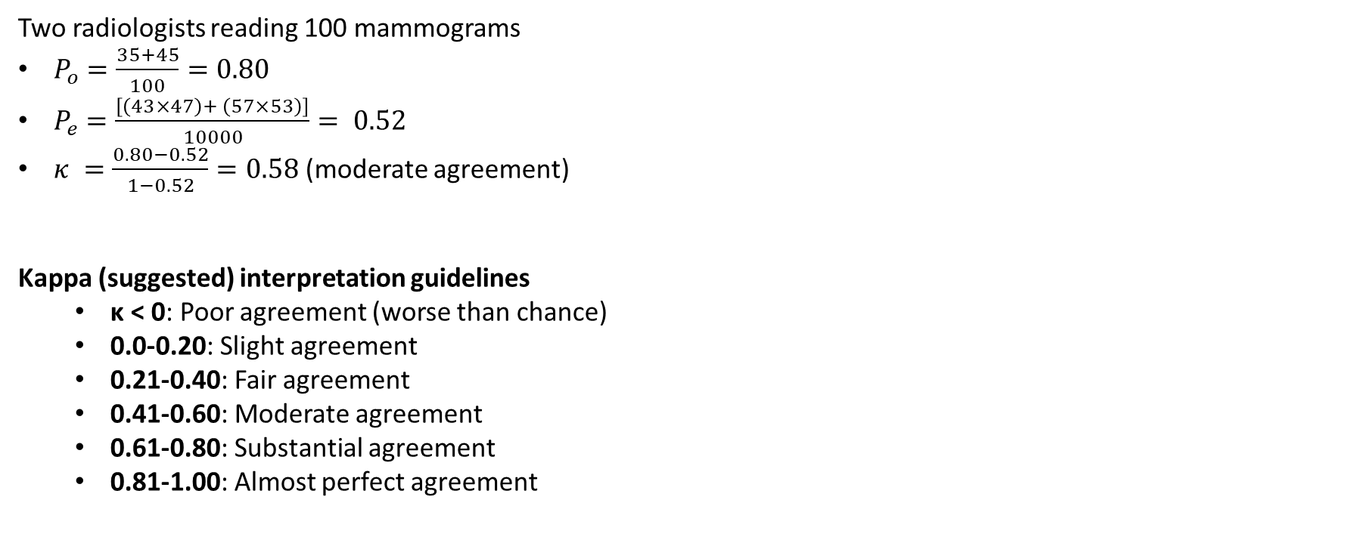
Example: Diagnostic Test Agreement
Two radiologists reading 100 mammograms
(moderate agreement)
Kappa (suggested) interpretation guidelines
  κ < 0: Poor agreement (worse than chance)
  0.0-0.20: Slight agreement
  0.21-0.40: Fair agreement
  0.41-0.60: Moderate agreement
  0.61-0.80: Substantial agreement
  0.81-1.00: Almost perfect agreement
 |  | Test 2
 |  | Positive | Negative
Test 1 | Positive | $$35$$ | $$8$$
 | Negative | $$12$$ | $$45$$

Slide 5
Similarities Between McNemar and Kappa
Both use 2×2 contingency tables* with paired/matched data
Both deal with correlated paired outcomes
Both focus on within-pair relationships
Both account for dependency in paired observations
Common Applications in Biostatistics
Diagnostic accuracy studies: Comparing two diagnostic tests
Inter-rater reliability: Agreement between clinicians
Before/after studies: Treatment effectiveness
Method comparison: New vs standard procedures
*Cohen’s Kappa can be used more generally

Slide 6
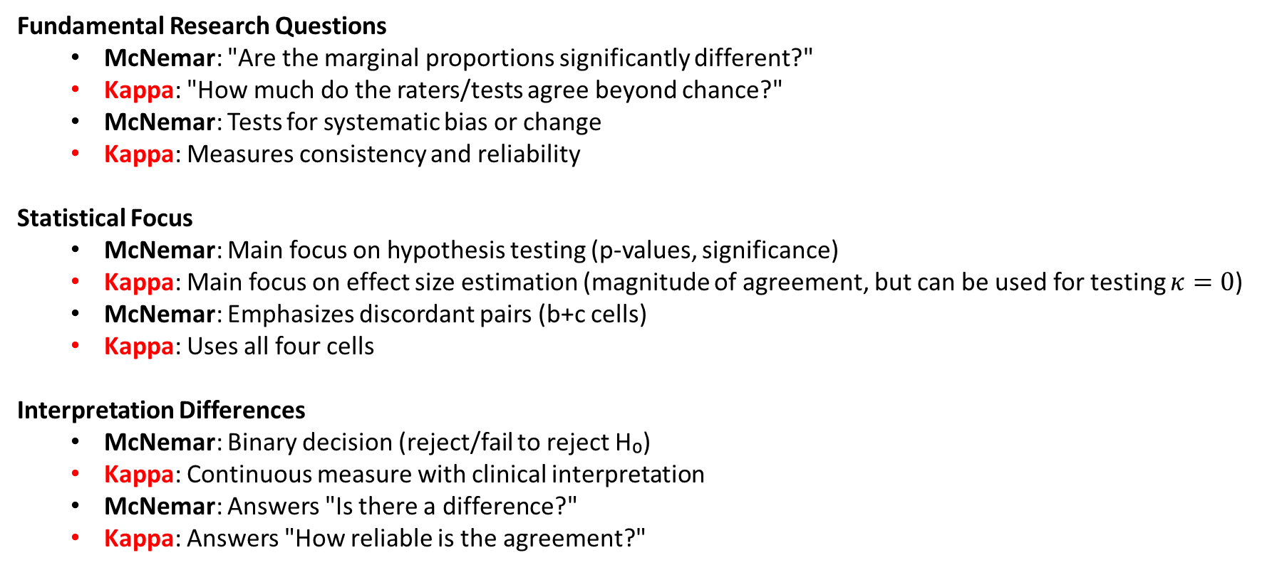
Key Differences
Fundamental Research Questions
  McNemar: "Are the marginal proportions significantly different?"
  Kappa: "How much do the raters/tests agree beyond chance?"
  McNemar: Tests for systematic bias or change
  Kappa: Measures consistency and reliability
Statistical Focus
  McNemar: Main focus on hypothesis testing (p-values, significance)
  Kappa: Main focus on effect size estimation (magnitude of agreement, but can be used for testing $κ=0$)
  McNemar: Emphasizes discordant pairs (b+c cells)
  Kappa: Uses all four cells
Interpretation Differences
  McNemar: Binary decision (reject/fail to reject H₀)
  Kappa: Continuous measure with clinical interpretation
  McNemar: Answers "Is there a difference?"
  Kappa: Answers "How reliable is the agreement?"

Slide 7
When to Use Each Test
Use McNemar test when:
  Primary goal: Test if proportions changed significantly
  Design: Pre/post intervention studies
  Question: "Did treatment improve success rate?"
  Example: Symptom improvement before vs after medication
  Focus: Statistical significance of change
  Paired binary outcome on the same items/subjects
    report effect (paired RD) and p-value.
Use Cohen's Kappa when:
  Primary goal: Quantify reliability or consistency
  Design: Inter-rater reliability studies
  Question: "How consistently do methods agree?"
  Example: Agreement between two diagnostic procedures
  Focus: Clinical significance of agreement level
  Agreement between raters/methods
    report κ with CI; add percent, pos/neg agreement.

Slide 8
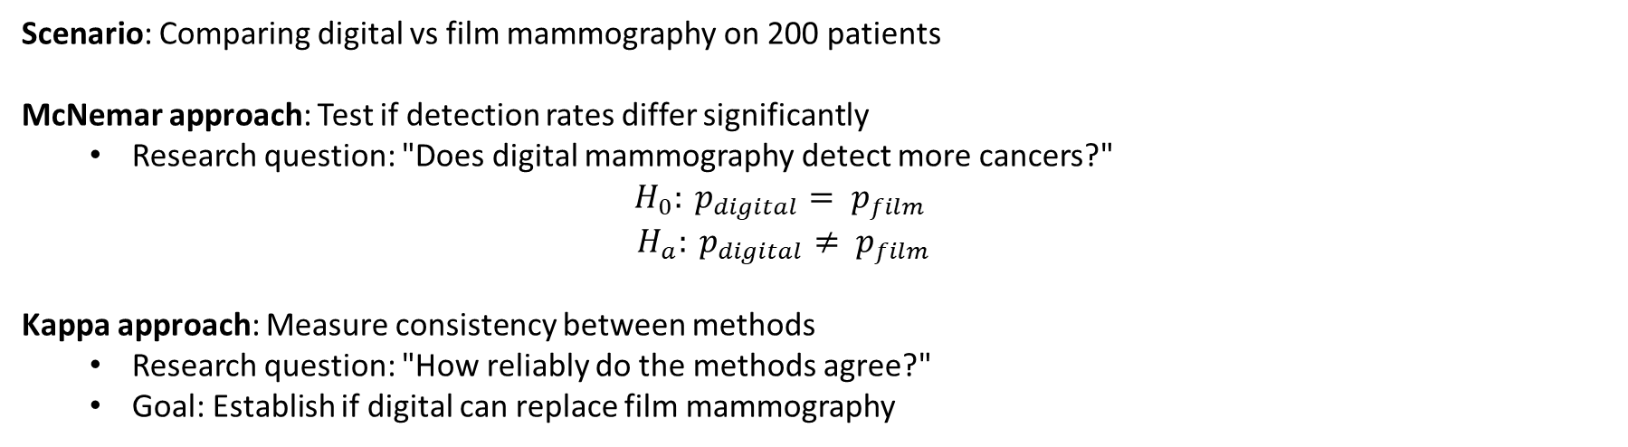
Clinical Example: Mammography Study
Scenario: Comparing digital vs film mammography on 200 patients
McNemar approach: Test if detection rates differ significantly
  Research question: "Does digital mammography detect more cancers?"
  $$H_{0}: p_{digital}= p_{film}$$
  $$H_{a}: p_{digital}≠ p_{film}$$
Kappa approach: Measure consistency between methods
  Research question: "How reliably do the methods agree?"
  Goal: Establish if digital can replace film mammography

Slide 9
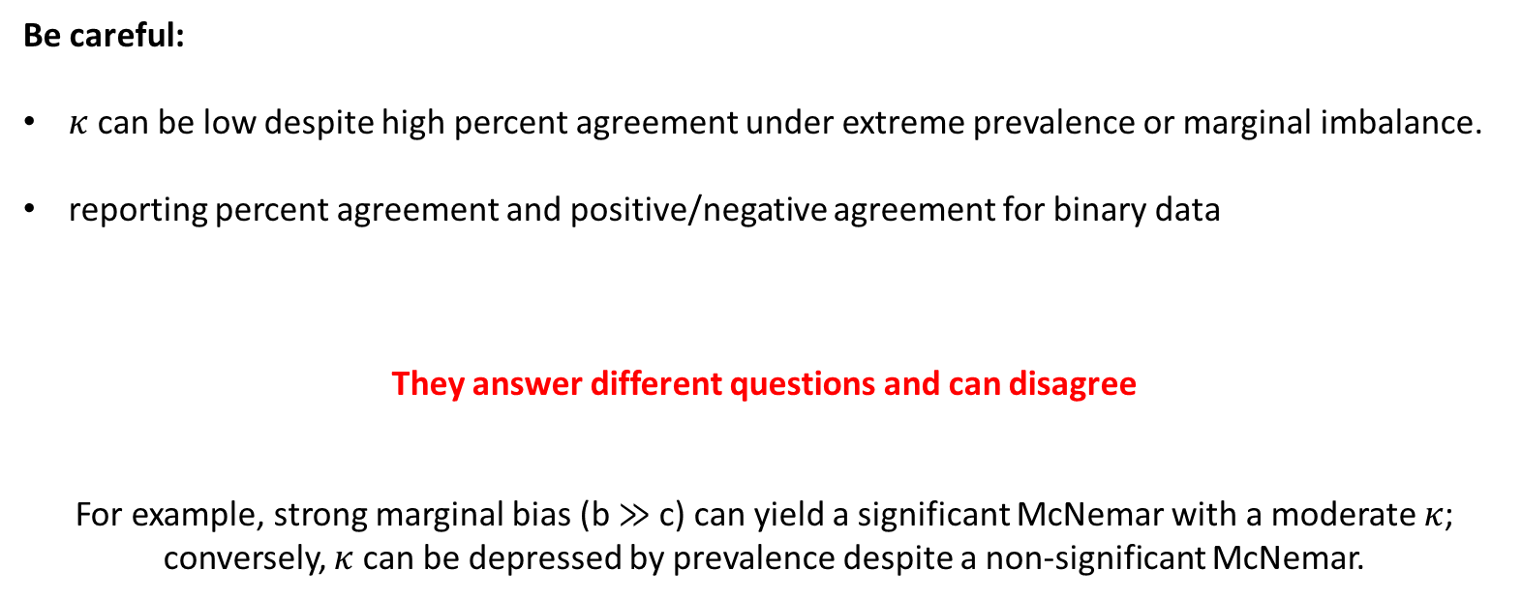
Conclusion
Be careful:
$κ$ can be low despite high percent agreement under extreme prevalence or marginal imbalance.
reporting percent agreement and positive/negative agreement for binary data
They answer different questions and can disagree
For example, strong marginal bias (b ≫ c) can yield a significant McNemar with a moderate $κ$; conversely, $κ$ can be depressed by prevalence despite a non-significant McNemar.

Slide 10
THANK YOU!

